Slide 1




HackOrbit 2025
Team Name
NextGen MedTech
(Trust. Transparency. Treatment. Powered by Blockchain)

Slide 2

THEME & PROBLEM STATEMENT
Theme: Web3 + Blockchain + Medtech
PROBLEM STATEMENT
Scattered Health Records : Medical data is saved in different hospitals. There’s no single view of a patient’s full history.
Weak Data Security : Health records can be hacked, lost, or changed , putting patient safety at risk.
No Patient Control : Patients have no control over who accesses their personal health information.
Fake Reports & Medicines : Some reports and drugs are counterfeit, which can lead to wrong diagnosis or treatment.
Slow Insurance Process : Claim approvals are delayed due to manual and unreliable verification methods.
No Transparency or Tracking : There’s no log showing who accessed data and when , reducing trust

Slide 3
SOLUTION
ArogyaBridge
(A decentralized, blockchain-powered Electronic Health Record (EHR) system.)
Solution Proposed By ArogyaBridge
Built on Ethereum Blockchain for secure and tamper-proof health data storage.
MetaMask Integration allows easy login and transaction signing.
Decentralized Approach improves data privacy, trust, and healthcare outcomes.
IPFS Integration ensures decentralized, transparent, and shareable data storage.
Role-based access to patients, doctors, and hospitals using MetaMask.
Patients can upload records, control doctor access, and view data history , control health data privacy.
Doctors can access patient lists, view reports, write consult notes, and manage permissions.
Diagnostic Centers create EHR reports accessible via IPFS for doctors and patients.

Slide 4
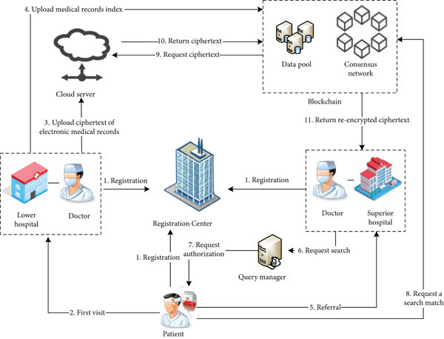
TECH STACK & FLOWCHART
Tech Stack
Frontend
React.js : For building the user interface
Web3.js : For interacting with Ethereum blockchain
Tailwind CSS : For styling the frontend
Wallet
MetaMask : For user authentication and blockchain transactions
Backend
Node.js + Express.js : For building backend APIs and server-side logic
Database
MongoDB : For storing user profiles and logs (non-blockchain data)
File Storage
IPFS : For decentralized file storage
Smart Contracts
Solidity : For writing smart contracts
Blockchain Platform : Ethereum or Polygon
Development Tools
Truffle : For developing, testing, and deploying smart contracts
Ganache : For local blockchain simulation during development

Slide 5
FEATURES AND NOVELTY
Features
Decentralized Storage → Medical files stored on IPFS for immutability and censorship resistance.
Smart Contract-Based Access Control → Patients control who can view or revoke access to their records.
MetaMask Integration → Users authenticate securely using Ethereum wallets—no passwords needed.
Role-Based Functionality → Separate access and actions for Patients, Doctors, and Labs.
Audit & Activity Tracking → All actions (uploads, access) are logged on-chain and in MongoDB.
Novelty
Patient-Centric Data Ownership → Shifts data control from hospitals to patients using blockchain.
Hybrid Decentralized + Centralized Model → Combines IPFS, Ethereum, and MongoDB for optimal performance.
Immutable Medical History → Every record and diagnosis is permanently referenceable and verifiable.
Trustless , Transparent Architecture → Eliminates reliance on centralized systems for trust and verification.
Scalable for Future Healthcare Use Cases → Easily extendable for insurance, e-prescriptions, or cross-border health sharing.

Slide 6
DRAWBACK AND SHOWSTOPPERS
DRAWBACK
Gas Fees on Ethereum → Interacting with smart contracts may involve high transaction (gas) costs on public chains.
User Complexity → Patients and doctors unfamiliar with MetaMask or wallets may find it hard to use.
Scalability Issues → Blockchain and IPFS are slower than centralized systems for large-scale real-time data access.
File Privacy Risks on IPFS → IPFS files are publicly accessible if CID is known—requires encryption for true privacy.
Limited Offline Access → Requires internet and wallet connectivity.
SHOWSTOPPERS
Data Privacy & Encryption Gaps
Problem: IPFS is public by design; if CID leaks, anyone can access sensitive medical files.
Impact: Violates patient confidentiality and legal regulations (e.g., HIPAA, GDPR).
High Gas Fees on Ethereum
Problem: Each interaction with the smart contract costs ETH gas fees.
Impact: Makes the system financially impractical for frequent usage.

Slide 7
TEAM NAME : Nextgen MedTech
Team Members
Ramanand Tomar : ramanandtomar1234@gmail.com
Rohit Patankar : rohitpatankar70@gmail.com
Shubh Pandey : 23cs10sh130@mitsgwl.ac.in
Shivang Yadav : 23ai10sh64@mitsgwl.ac.in

Slide 8
Thank you

